Slide 1
A surprising discovery
Notes:
Hook: Use narration to engage students. The Guadalupe Mountains are in Central America near the Mexican border.

Slide 2
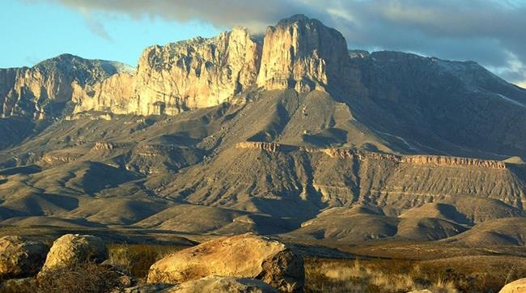
Geologists studying the sedimentary rocks in the Guadalupe Mountains discovered so many marine type structures and so many fossils of marine animals that they realized that this area had once been an ancient reef that was over 600 metres long.
The sea eventually began to gradually dry up, meaning that the reef died, but it was preserved under layers of sediment. The reef is estimated to be 250 to 280 million years old.
Main reef area (vertical alignment)
Fore reef area (slopes up towards the main reef)
The reef remained obscured until about 80 million years ago, when tectonic processes began to slowly uplift the entire region. Faulting between 20 and 30 million years ago uplifted a large, long-buried section of the reef. The uplift exposed the rocks to erosion, which wore away soft sediments and exposed the resistant reef of the Guadalupe Mountains that we see today.
Notes:
From MCSHS to MCHS is 600m. How did the reef end up on top of a mountain?

Slide 3
Notes:
What – why – how activity
What is it? Why is it here? How did it get here?
What are these unusual fossils and how did they end up here?

Slide 4
Notes:
The fossils in the Guadalupe Mountains come from a prehistoric reef. This diagram shows 3 fossil specimens and the organisms that created them.

Slide 6
Layers of time
Fossils form in layers of sedimentary rock.
Geologists use their understanding of how sedimentary layers form to order fossils from oldest to youngest.
This is a bit like counting the rings in a tree stump to find out how old the tree is.
Notes:
Horizontal rock layers are seen around the world: Grand Staircase-Escalante National Monument, USA (left); The Twelve Apostles, Australia (centre); Quebrada de las Conchas, Argentina (right).

Slide 7
Fossil formation
Time for some teacher led notes on how this unlucky dino turned into a fossil. (next slide)

Slide 8
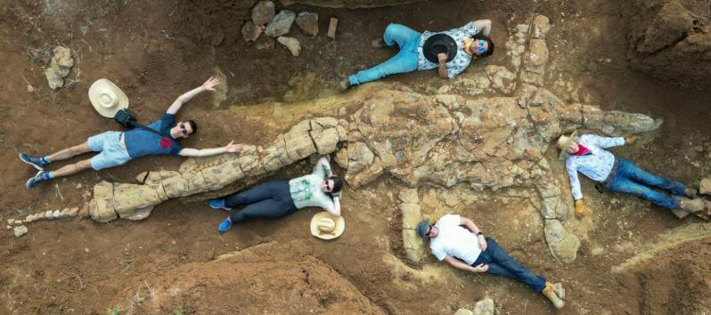
Key steps in the fossilisation of a animal
When the animal dies the body of the animal is relatively undisturbed (by predators, scavengers, floods etc)
The soft fleshy parts of the body decay
The remains get covered with layers of sediment
The layers of sediment build up as the soft parts of the remains completely decay away
The layers of sediment build up more and more and the bones become incorporated into a rock layer well under the surface of the earth.
Uplift occurs and the rock layer is move back to the surface of the earth.

Slide 9
This diagram shows sedimentary rock layers. Four fossils (A–D) were found at the locations shown.
Notes:
B, A, C, D

Slide 10
Order the fossils from oldest to youngest.
Notes:
Class discussion. Answer: B, A, C, D

Slide 11
Another fossil (E) is found.
Which two statements about this fossil are true?
1). It is the oldest fossil in the group
2) It is about the same age as fossil A
3) It is about the same age as Fossil D
4) It is younger than Fossil B but older than Fossil C
Notes:
Formative assessment – students to hold up responses with fingers.
Fossil E is about the same age as Fossil A. Fossil E and Fossil A were found in the same layer of rock, so they must have been formed at around the same time.
It is younger than Fossil B but older than Fossil C. Fossil E is in a higher rock layer than fossil B, so B must be older. But it's in a lower layer than Fossil C, so C must be younger.

